Slide 1

Trail Guard
Progress Report
220054N Balasooriya BAPI
220112R Dewasumithra MPO
220128V Dineshara MC
220143L Diunugala CH

Slide 2

Overview
Project Trail Guard is aimed at developing a portable, efficient device capable of monitoring environmental parameters such as air and water quality. This device utilizes a range of sensors including turbidity, pH, temperature, dust, pollen, and recently integrated MQ2 gas and TDS (Total Dissolved Solids) sensors. These enhancements broaden the scope of our device, making it valuable for both travelers and residents concerned with local environmental conditions

Slide 3
Recent Developments
Battery and Charging System
Time interval between
charging sessions
Trade offs
Weight and time taken to fully charge

Slide 4
Recent Developments
Battery and Charging System
Display Enhancements
Power consumption
Trade offs
User experience

Slide 5
Recent Developments
Battery and Charging System
Display Enhancements
Solar Power Update
Bulkiness of the device
Trade offs
Extended continuous usage time

Slide 6
Recent Developments
Battery and Charging System
Display Enhancements
Solar Power Update
Sensor Integration
MQ2 Gas Sensor (CO, CO2, Methane, LPG, Propane)
TDS Sensor (total dissolved solids)

Slide 7

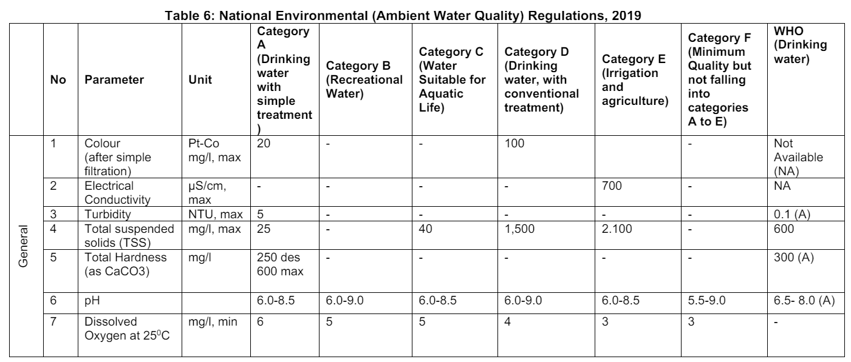
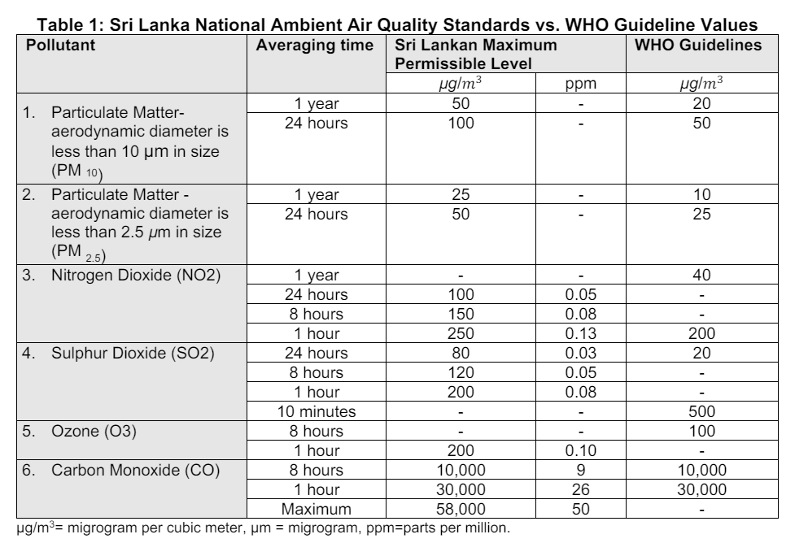
Water and Air Quality Parameters

Slide 8

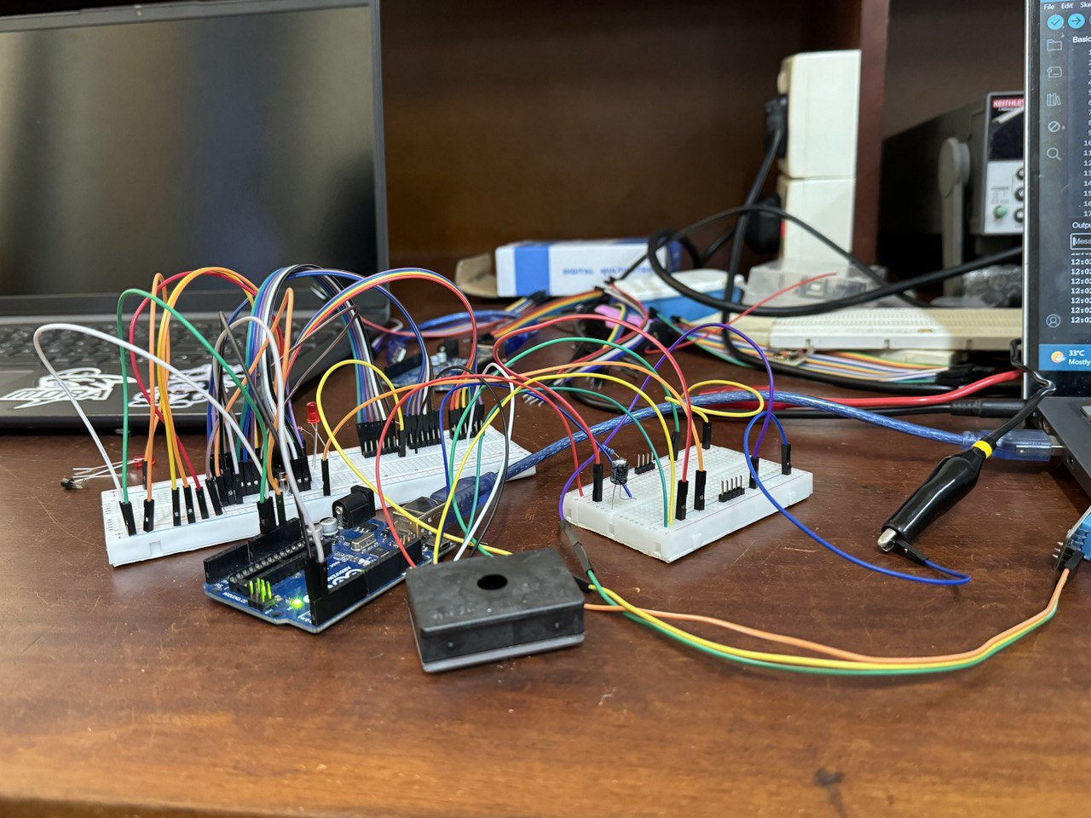
Circuit Testing and Validation
Testing the circuit on the breadboard was a success. Tested key functionalities include:
Sensor integration and operation
Display clarity and data output
Power system efficiency

Slide 9


Next Steps
Transition from breadboard to PCB
Integrate sensor circuits directly onto the PCB, eliminating individual modules to minimize cost and reduce space usage.
Extended testing
Assess battery life and recharge times to optimize battery configuration.
Conduct user testing to evaluate device usability and gather feedback.
Sensor | Price (Rs.)
TDS sensor | 3350
Temperature and humidity sensor | 230
MQ-2 gas sensor | 580

Slide 10
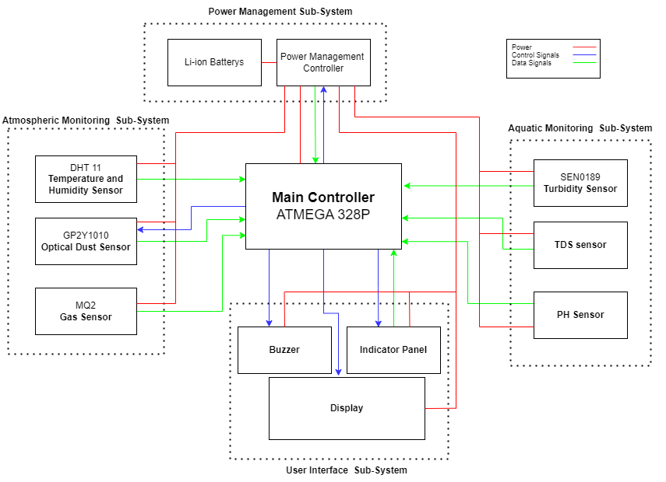
Finalized Block Diagram

Slide 11
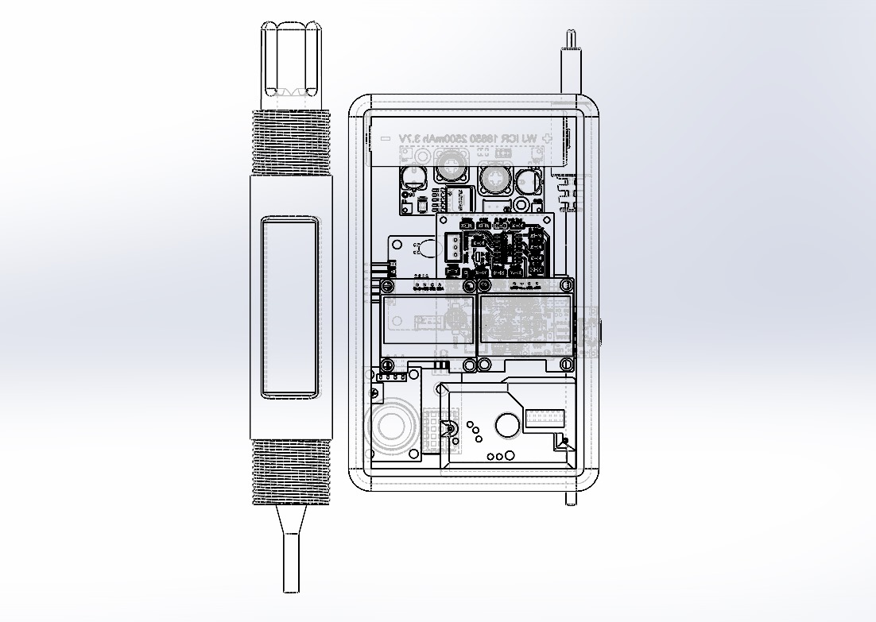
Finalized Enclosure Design

Slide 12
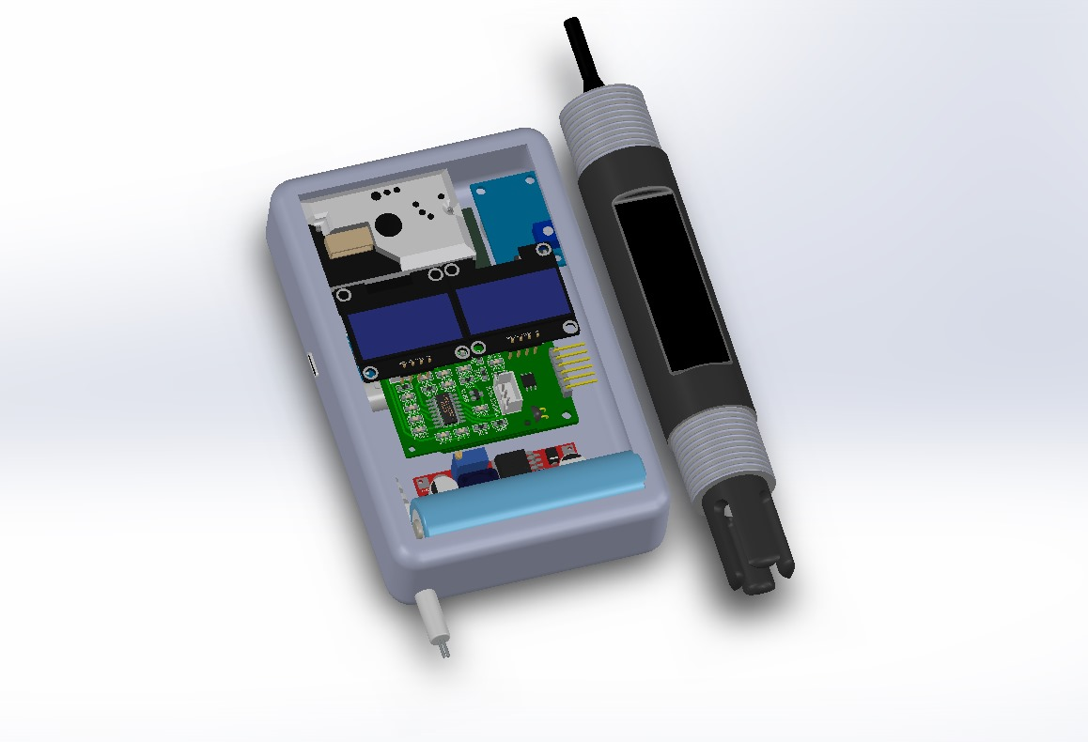
Finalized Enclosure Design

Slide 13

THANK YOU!

